Slide 1


TangrAI
Pau Cutrina, Carles pregonas

Slide 2

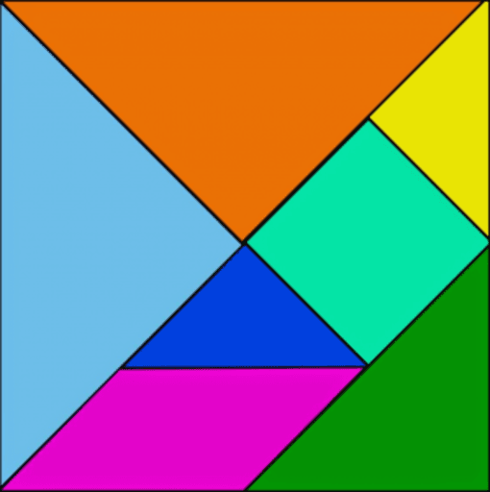
Pau Cutrina, Carles Pregonas
Introduction
An innovative technique to resolve organize problems is proposed in the following project.
Reinforcement learning (RL) as a powerful artificial intelligence unsupervised tool is used to show how the computer can solve the game of Tangram. Is the first time that RL has been used in this game.

Slide 3

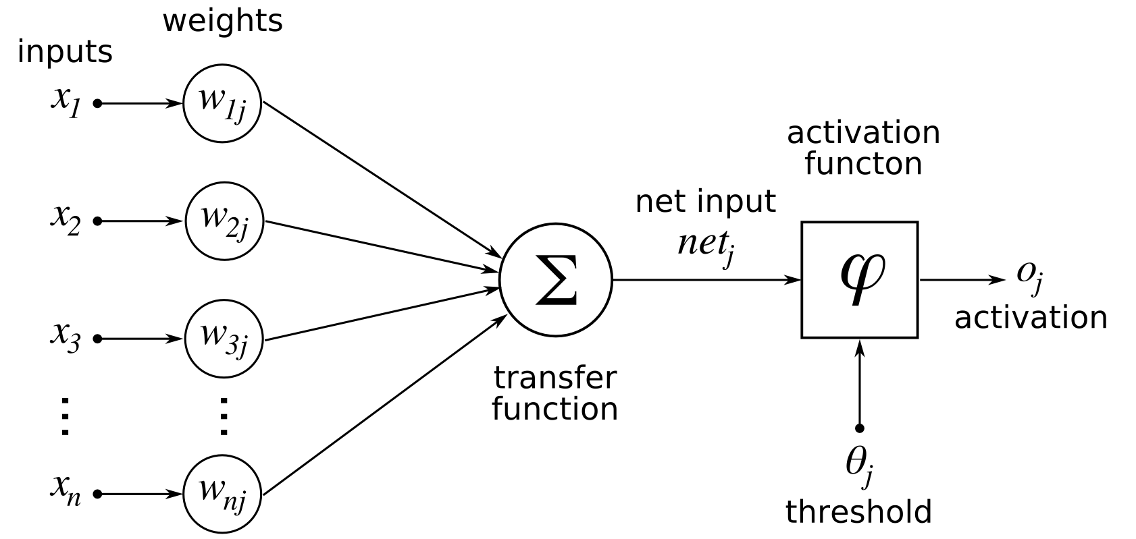
Neural Network Structure
Pau Cutrina, Carles Pregonas
Activation functions:
Relu and Softmax as output
Optimizer:
Adam

Slide 4

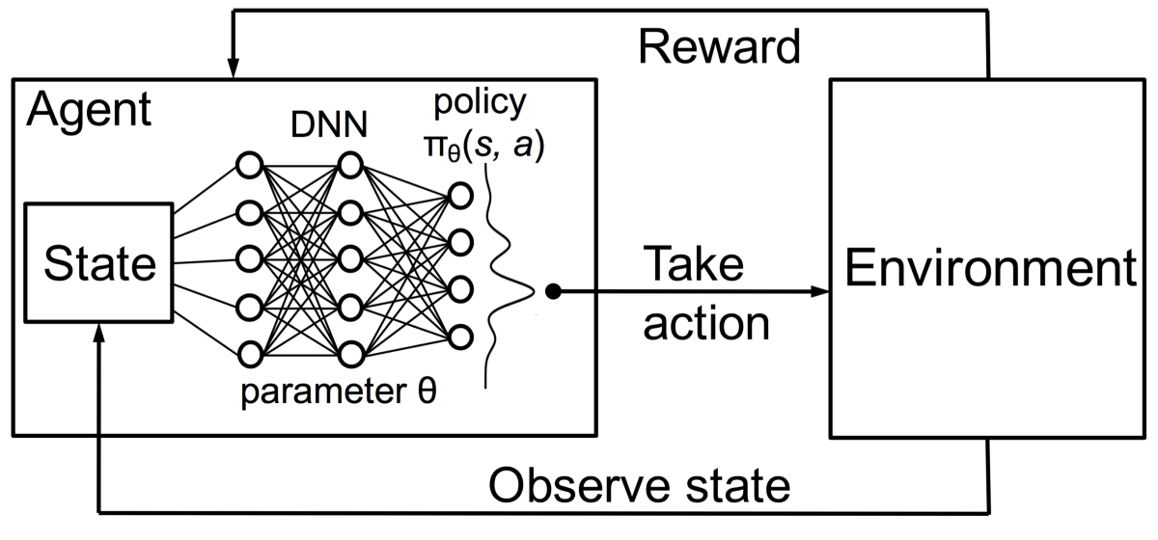
Reinforcement Learning structure
Pau Cutrina, Carles Pregonas
Reward: Number empty positions
Agent: Positions X and Y
State: Possible displacements
Environment: Game conditions and rendering

Slide 5

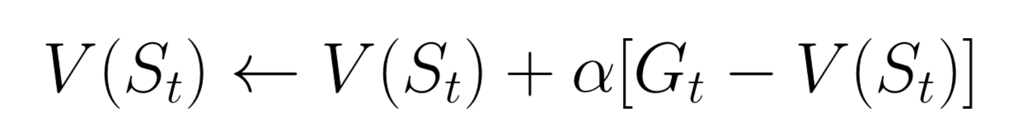
Montecarlo algorithm
Pau Cutrina, Carles Pregonas
It required experience (states, actions and rewards) from interaction with the environment. The reward is based on the final score.

Slide 6
Files structure
Pau Cutrina, Carles Pregonas
HackathonCU\
setup.py
tangrai_agent.py
tangrai
__init__.py
envs\
__init__.py
tangrai_engine.py
tangrai_env.py

Slide 7
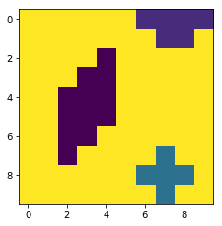
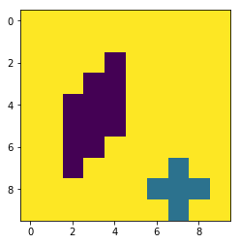
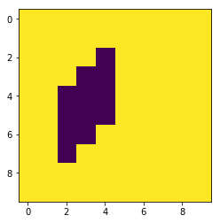
Pau Cutrina, Carles Pregonas
Results
We didn’t finish the training because of the time. Anyways, the training shows a progressive learning that could be improved increasing the training epochs.

Slide 8
Thank You!
paucutrina@gmail.com
CARLES.PREGO@GMAIL.COM

